Slide 1
Hello!
I am Varnit Goyal
I am here to tell you how to get started with machine learning

Slide 2
Getting Started With ML

Slide 3
Who is going to top exams this year ?

Slide 4
So what is ML?
1
Predicting the unknown

Slide 5
Types of Machine Learning
Supervised Learning
Supervised learning is when we use algorithm to learn mapping between input and output function.
Unsupervised learning
Unsupervised learning is when you only give input but no corresponding output, the algorithm learns on its own.

Slide 6
Our Agenda
Terms to know before getting started
Tools required before getting started
Practical example
Queries

Slide 7
Types of Supervised Learning
Classification
Classification problem is when the output is a category for ex - topper, average, failure..
Regression
Regression is when the output is a real value for ex- percentage, value etc.

Slide 8
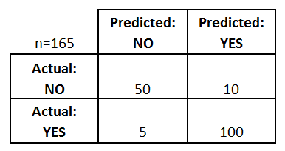
Confusion matrix

Slide 9
Load the dataset
Prepare the dataset
Split the dataset
Train
Test
Train with Algorithm
Predict
Metrics

Slide 10
Tools Required
2

Slide 11
Tools required to get Started
Python
Scikit learn
Jupyter notebook
Numpy and pandas
Some other frameworks
Cloud computing (optional)

Slide 12
Cloud Computing
Role of cloud computing

Slide 13
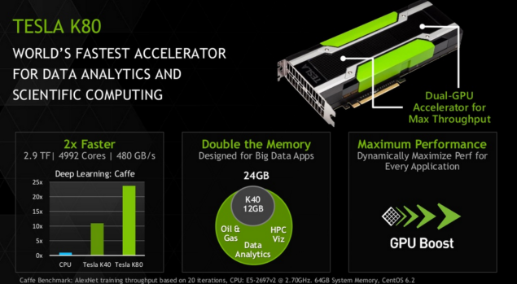

Slide 14
Cost
5000$
The whole pc would cost more than 7000$

Slide 15
Thanks!
Question will be appreciated
You can find me at:
varnitgoyal95@gmail.com
+919412522023 (whatsapp)
https://github.com/varnitgoyal95

